Slide 1
FULL STACK PROJECT
On
E-LEARNING
Khushal Goyal, Kumar Garg, Keshav Garg, Kavita Jora
2210991791,2210991820,2210991782,2210991773
Supervised By
Mr. RAHUL
Department of Computer Science and Engineering,
Chitkara University, Punjab

Slide 2
Introduction
The project aims to develop a cutting-edge e-learning platform, inspired by popular platforms like Scalar, with a unique emphasis on providing job opportunities alongside skill development. This platform will not only offer high-quality educational content in areas like full-stack development.
Through a combination of interactive lessons, live coding challenges, and industry-relevant courses, users will be equipped with the necessary skills to succeed in the tech industry. Additionally, the platform will connect learners with job opportunities through collaborations with tech companies, internships, and recruitment drives.
2

Slide 3
Problem Statement
The current job market faces a significant gap between the skills candidates possess and the expectations of employers. Students and professionals struggle to find platforms that not only teach relevant, industry-demanded skills but also provide meaningful job opportunities upon course completion.
As a result, the tech industry continues to experience a talent gap, where companies are unable to find skilled professionals, and learners face difficulty in accessing job opportunities that match their skillsets. This gap between education and employment opportunities is a key issue that needs to be addressed.

Slide 4
Features
Efficient Data Management :
Handles data storage, retrieval, and processing with high efficiency.
Scalable Performance:
Adapts to increasing loads and user demands without compromising performance.
Security and Compliance:
Implements strong security measures to protect data and user information.
User-Friendly Interface:
Simplifies backend management with an intuitive interface for configuration and monitoring.

Slide 5
Financial Benefits
Revenue from Subscriptions: Generate consistent income through premium course subscriptions and certifications.
Job Placement Partnerships: Charge companies for successful candidate placements through recruitment services.
Freemium Model: Attract users with free courses, then upsell premium content and features.
Sponsored Content & Ads: Generate revenue through partnerships and advertisements with tech companies.

Slide 6
Target Audience
Students and Graduates: Individuals seeking to enhance their skills or gain industry-relevant knowledge.
Working Professionals: Those looking to upskill or transition into new roles within the tech industry.
Job Seekers: People searching for job opportunities in tech, seeking training that aligns with industry needs.
Tech Companies: Organizations looking to hire skilled talent through a platform offering job placements.

Slide 7
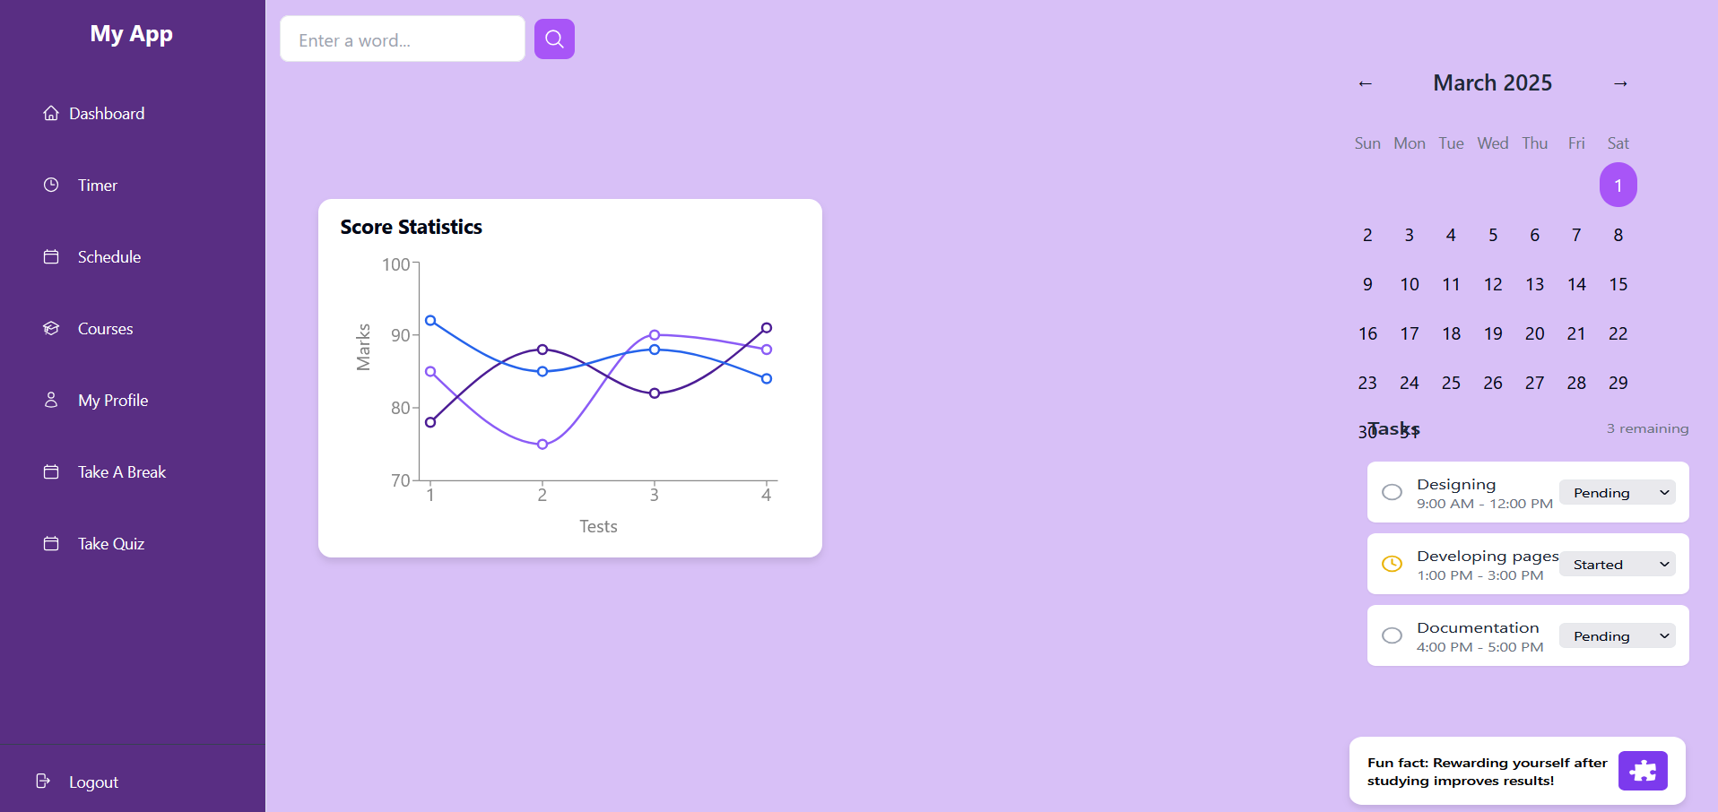
Screenshot

Slide 8
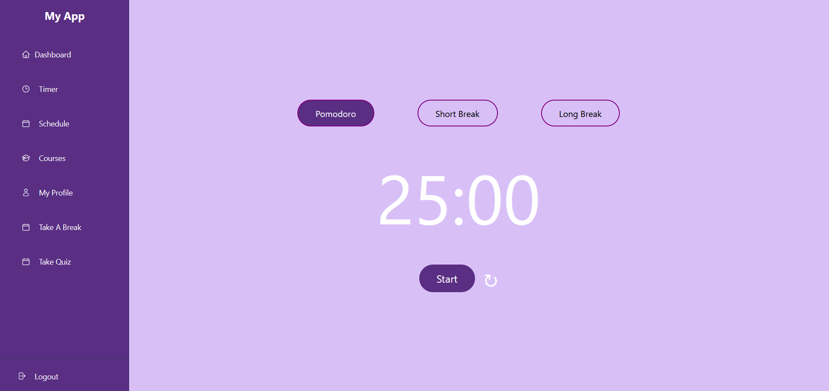
Screenshot

Slide 9
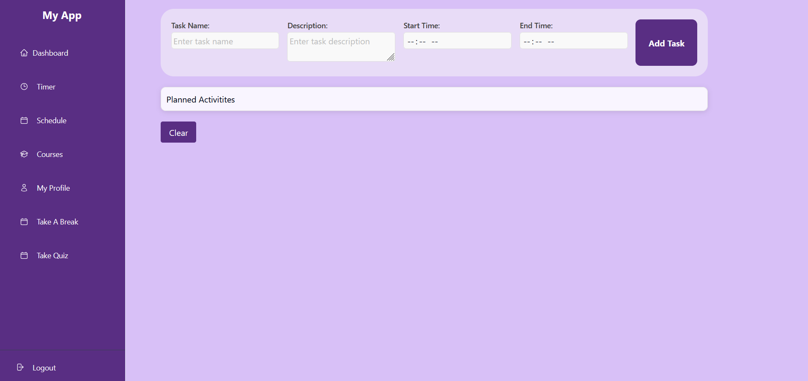
Screenshot

Slide 10
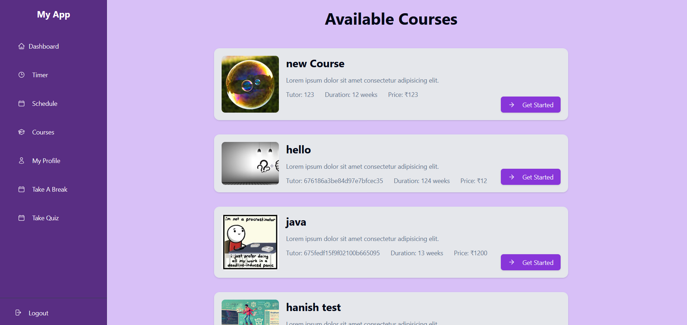
Screenshot

Slide 11
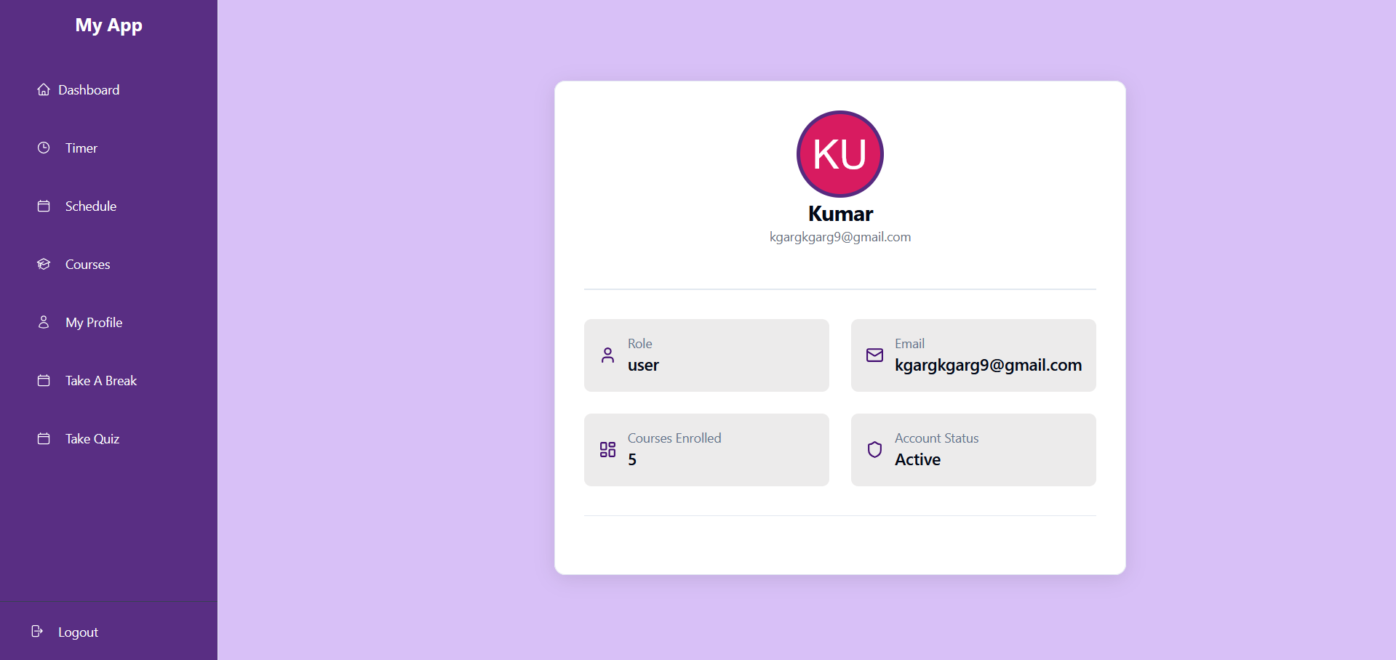
Screenshot

Slide 12
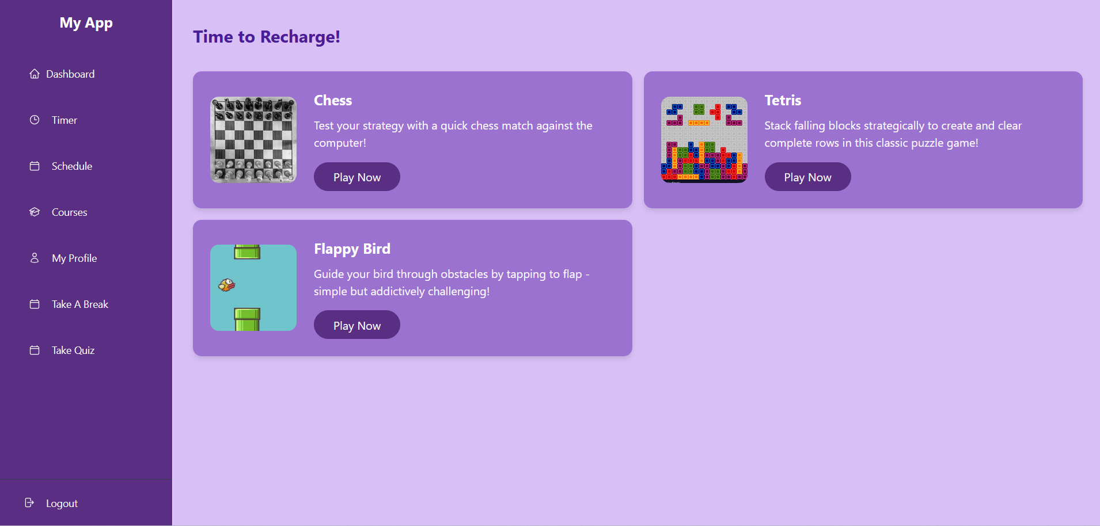
Screenshot

Slide 13
Screenshot

Slide 14
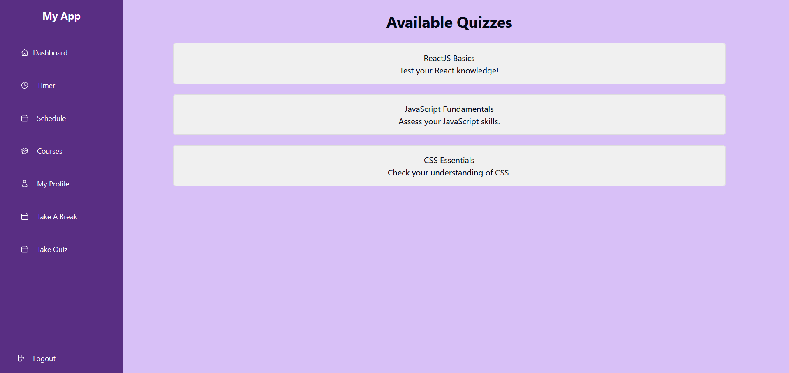
Screenshot

Slide 15
Conclusion
The e-learning platform is designed to empower learners by providing them with industry-relevant skills and knowledge, bridging the gap between education and employment. It offers career advancement opportunities through access to job placements, ensuring that users are job-ready with up-to-date training materials. By focusing on scalability and user-centric features, the platform aims to grow with the increasing demand for tech talent and job opportunities, enabling individuals to advance their careers and stay ahead in the competitive job market.

Slide 16
Thank You
16

